Slide 1
11289 Observations x 30 Factors
191 Countries and 60 Years Represented
Select only socioeconomic factors
Remove factors with <1000 observations
11289 Rows x 6 Factors
Normalize and center data
Remove observations with missing values
1021 Observations x 6 Factors

Slide 2
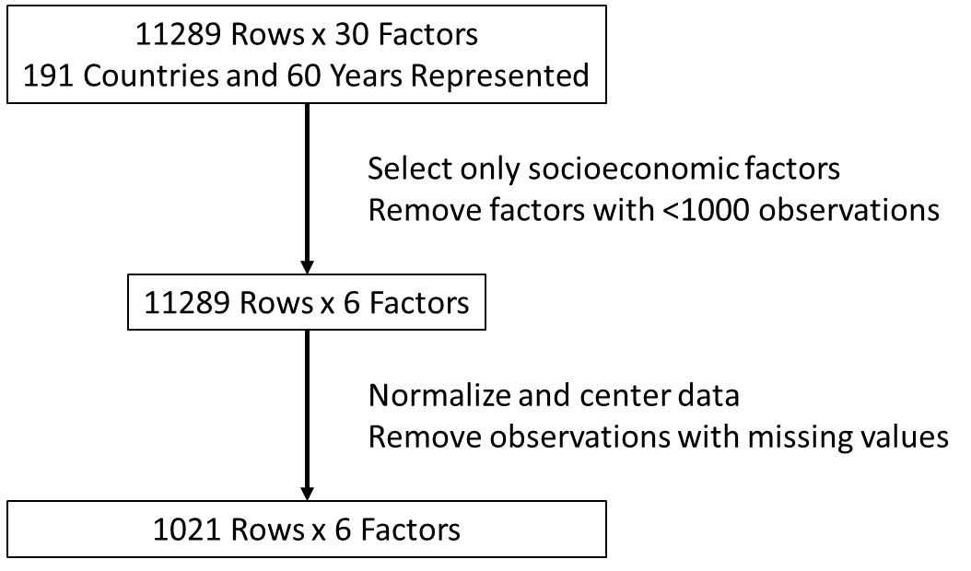

Slide 3
1
Start vs end rows by area
2
Start vs end rows*factors by area
Initial Composite Data
11289 Observations, 30 Factors
11289 Observations, 30 Factors
Data Filtered For Completeness
1021 Observations, 6 Factors
1021 Observations, 6 Factors

Slide 4
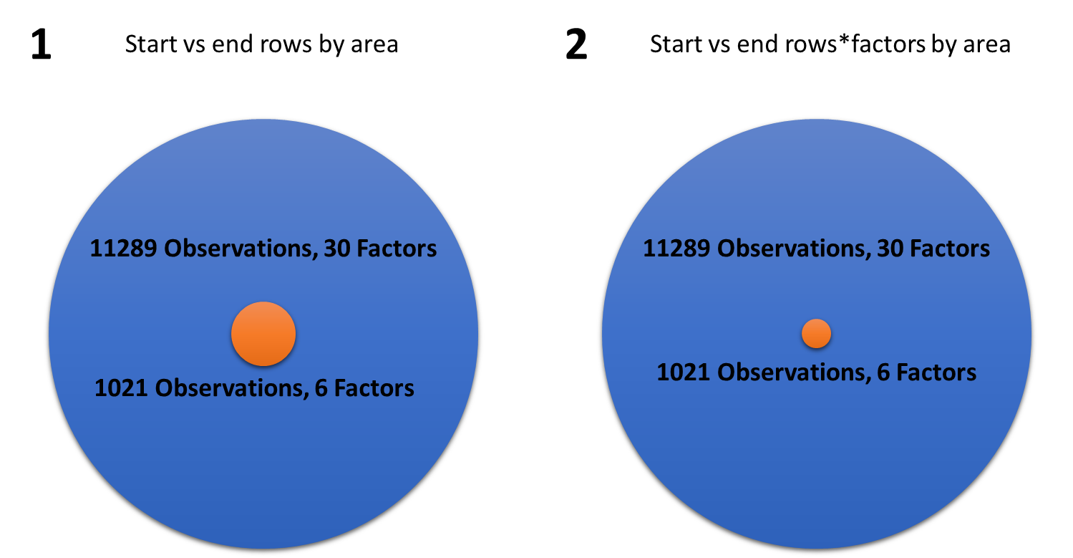

Slide 5
3
1021 Observations, 6 Factors
11289 Observations, 30 Factors

Slide 6
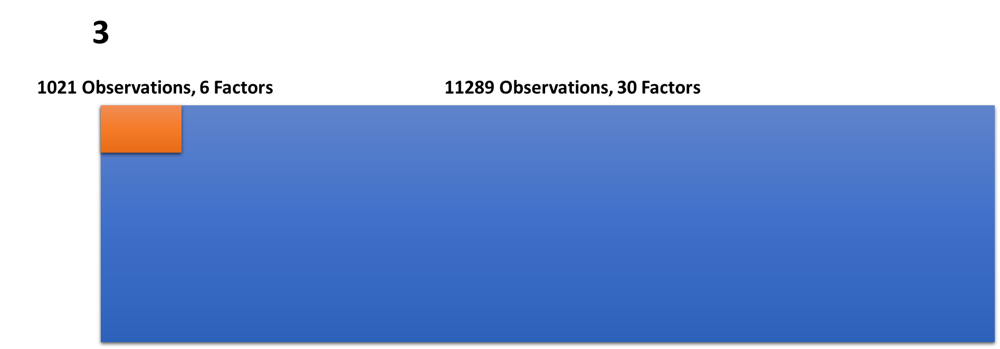

Slide 7
A
B
C
Initial Composite Data
11289 Observations, 30 Factors
Initial Composite Data
11289 Observations, 30 Factors
Data Without Missing Values
1021 Observations, 6 Factors
Data Without Missing Values
1021 Observations, 6 Factors
Initial Composite Data
11289 Observations, 30 Factors
Data Without Missing Values
1021 Observations, 6 Factors

Slide 8
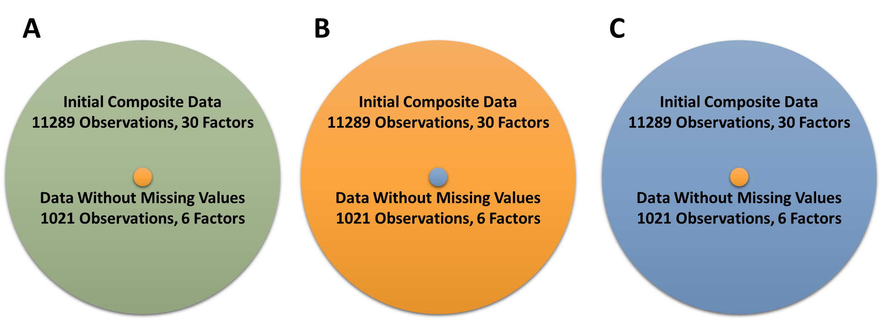

Slide 9
Initial Composite Data
11289 Observations, 30 Factors
Data Without Missing Values
1021 Observations, 6 Factors

Slide 10
